Slide 1



Indicators of Compromise
Industrial Control System Security Workshop
June 22-23, 2017

Slide 2
Indicators of Compromise
Artifacts or events observed on systems or networks that provide a high degree of confidence that an intrusion has occurred.

Slide 3
Traditional Forensic Artifacts
Hash value (MD5 Signature)
Compile time
File Size
Path Locations
Registry Keys
Memory

Slide 4
TOP Indicators of Compromise
Unusual Outbound Traffic
Behavior Anomaly on Privileged Account
Unusual Geographical Connections
High Volume of Database Transactions
Spike on Web Traffic Activity
Activity on Obscure Port
Suspicious Registry Edits
Unexpected System Patch
Signs of DDoS Attacks
Presence of unfamiliar files

Slide 5
Methodology of creating an IOC
Do not focus on specific pieces of forensic evidence
Focus instead on the common thread of actions such as recurring tactics or tools used by adversaries
Use an iterative and looped continuous improvement processes.

Slide 6
IOC Development Cycle
IOC
Creation
IOC
Deployment
Identification
Of Suspect Systems
Preserve/Collect
Evidence
Data Analysis
Source: www.openioc.org White paper: “Sophisticated Indicators for the Modern Threat Landscape: An Introduction to OpenIOC.” 2013.
Notes:
IOC Creation: Network and Host IOCs
Deployment: IDS/IPS/HIDS/HIPS/SIEM
Identiication of Suspect Systems
Preservation and Collection: Forensic image, Log data collection, Memory preservation
Data Analysis: Log data review, forensic analysis, malware analysis

Slide 7
Properties of the best IOCs
IOC identifies only attacker activity
IOC is inexpensive to evaluate
IOC is expensive for the attacker to evade
Source: www.openioc.org White paper: “Sophisticated Indicators for the Modern Threat Landscape: An Introduction to OpenIOC.” 2013.
Notes:
1. The IOC identifies only attacker activity.
2. The IOC is inexpensive to evaluate – it is typically simple and evaluates information that is less
expensive to collect or calculate.
3. The IOC is expensive for the attacker to evade. In other words, to evade the IOC the attacker
has to drastically change tactics, tools, or approach.

Slide 8
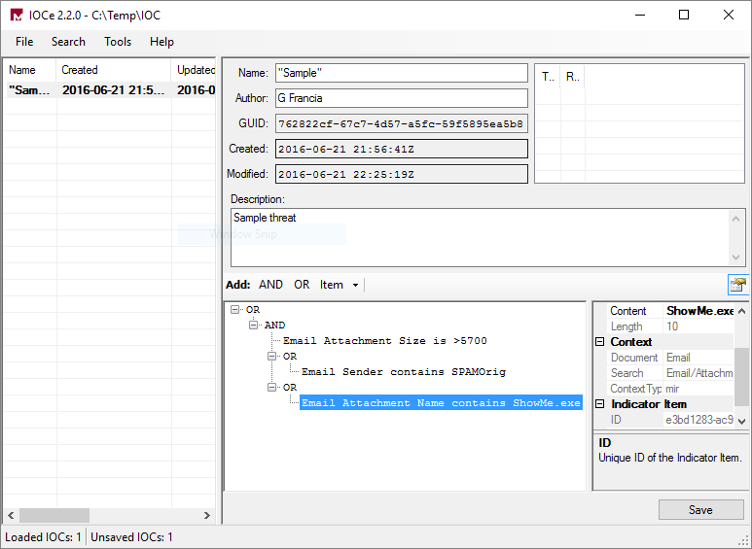
Mandiant IOC Editor
Free Tool for creating IOCs with a graphical user interface
Available at the FireEye® (Mandiant) Web site: https://www.fireeye.com/services/freeware/ioc-editor.html

